Slide 1
COMP2610/6261 Tut 10 Summary

Slide 2
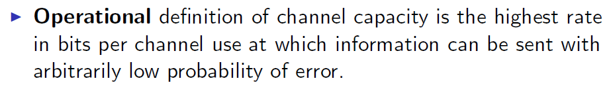
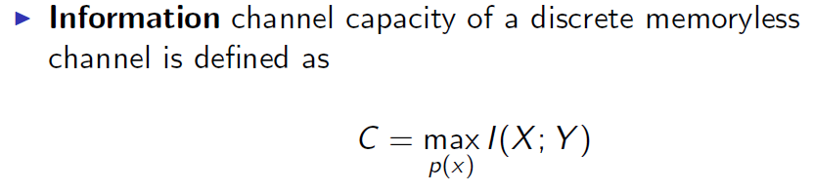

Information and Operation Channel Capacity

Slide 3
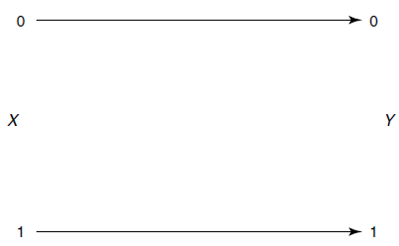

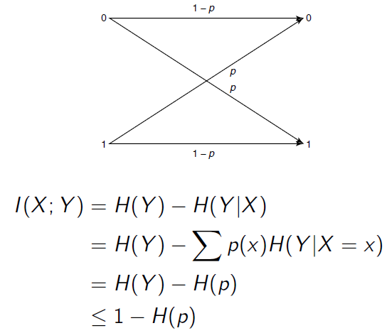
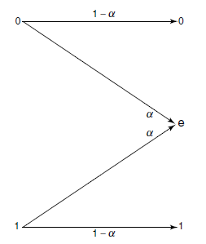
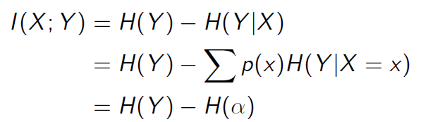

Channel Capacity Examples
Error Free Channel
Binary Symmetric Channel
Binary erasure channel

Slide 4
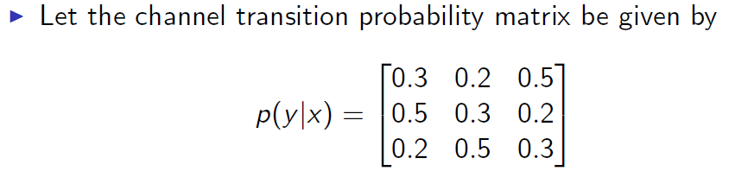
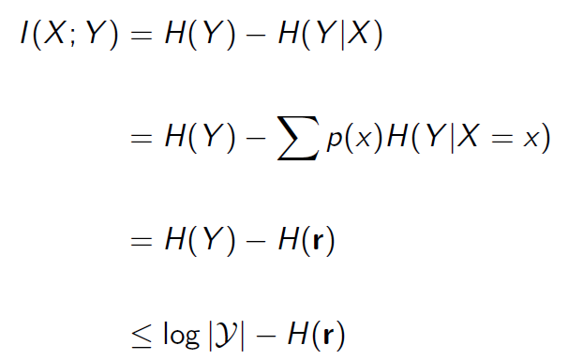
Symmetric Channel

Slide 5



Channel Capacity Properties
Property 1
Property 2
Property 3
Property 4
Property 5

Slide 6
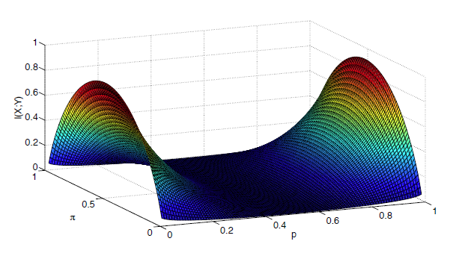
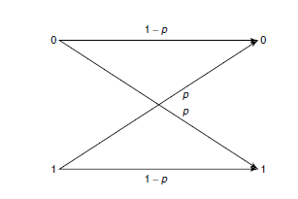
Channel Capacity Properties
Property 6

